Slide 1


Slide 2


Scalable competitor data analysis and BI reporting solution
Second Year Project Synopsis
Submitted by
ROLL | NAME
2301010160 | PRAKHAR
2301010177 | ADITYA JHA
2301010155 | SHUBH RAI
2301010156 | CHETAN
Industry Mentor:
Faculty Mentor: Dr. Ashwani Kumar
Notes:
New Courses replaced with New Programmes

Slide 3

Project Overview
Brief Overview of the Topic
The Scalable competitor data analysis and BI reporting solution enables businesses to collect, process, and analyze competitor data from various sources in real-time. It integrates cloud-based data storage, and advanced analytics (AI/ML) to uncover trends, benchmark performance, and predict market shifts.
Notes:
New Courses replaced with New Programmes

Slide 4
About the Problem
Problems Identified
Ensuring high-quality data and effectively integrating information from diverse sources are critical for accurate analysis.
As data volumes grow, BI solutions must efficiently scale to handle increased demands without compromising performance.
Protecting sensitive information and complying with data privacy regulations are paramount to maintain trust and avoid legal issues.
Issues or Problems
Encouraging employees to embrace new BI tools and processes is essential for successful implementation.
The expenses associated with hardware, software, and ongoing support can be substantial, posing financial challenges for organizations.
Notes:
New Courses replaced with New Programmes

Slide 5
About the Problem
Need for Solution
By analyzing comprehensive data, businesses can make informed decisions, leading to improved strategies and outcomes.
Gaining insights into competitors' strengths and weaknesses allows businesses to identify opportunities and develop strategies to outperform them.
Existing Solutions
Microsoft Power BI – A powerful business analytics tool that provides real-time dashboards, AI-driven insights, and seamless integration with Microsoft products.
Tableau – A leading BI platform offering advanced visual analytics, predictive modeling, and scalability for large datasets.
Notes:
New Courses replaced with New Programmes

Slide 6
Problem Statement
Problem Definition
Businesses struggle to gain real-time, actionable insights from competitor data due to fragmented data sources, scalability limitations, and inefficient BI reporting. Traditional methods require manual data collection, leading to delays, inaccuracies, and missed opportunities.
Why is it Important?
Strategic Decision-Making
Improved Business Performance
Expected Impact
Informed Decision-Making
Enhanced Competitive Advantage
Notes:
New Courses replaced with New Programmes

Slide 7
Objectives
Main Goal of the Project
To empower businesses with actionable insights that can drive smarter, data-driven,decisions,ultimately improving their competitive positioning and operational performance.
Specific Objectives
Automated Data Collection and Integration
Comprehensive Competitor Analysis
Data-driven Decision Support
Real-Time Market Intelligence
Notes:
New Courses replaced with New Programmes

Slide 8
Methodology, Tools, and Techniques
Methodology, Tools, and Techniques
Approach: Automated data collection, integration, and advanced analytics to provide real-time, actionable competitor insights through scalable BI dashboards and predictive models.
Tools & Software:
Data Collection: Scrapy for Python Framework.
Data Integration: Talend for data cleansing and integration.
Business Intelligence & Reporting Tools: Power BI and Tableau for Visualization.
Cloud & Hosting Platforms: AWS and Google Cloud for data processing and reporting.
Notes:
New Courses replaced with New Programmes

Slide 9
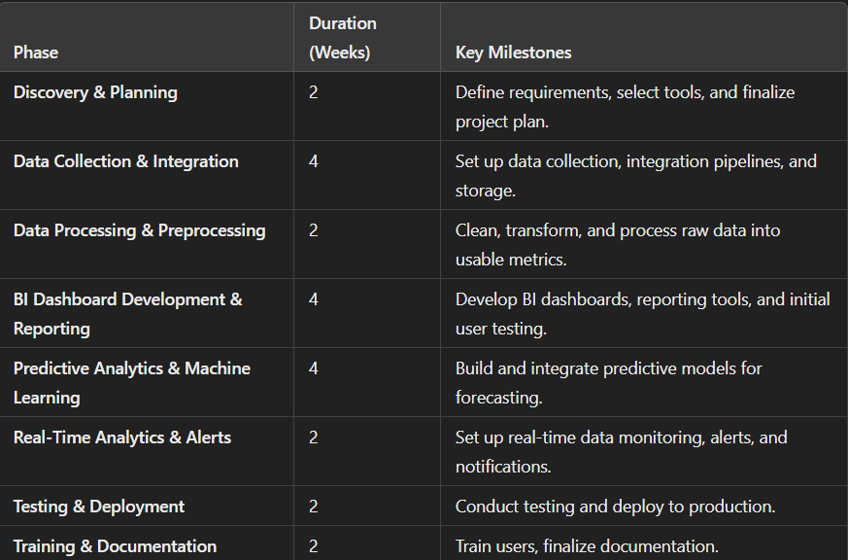
Project Timeline
Notes:
New Courses replaced with New Programmes

Slide 10
Expected Results & Impact
Expected Results:
Improved Competitive Insights
Enhanced Decision-Making.
Increased Market Agility.
Improved Customer Satisfaction
IMPACT
Cost Savings & Efficiency
Market Share Growth
Scalable, Sustainable Solution.
Notes:
New Courses replaced with New Programmes

Slide 11
References
Research Papers:
Liu, L., & Liao, S. (2012). "Competitive Intelligence in Business: A Review of Methods." International Journal of Business and Social Science, 3(9), 87-95. Retrieved from IJBSS
Fader, P. S., & Hardie, B. G. S. (2010). "The Role of Predictive Analytics in Competitive Strategy." Journal of Strategic Marketing, 18(4), 301-314. doi: 10.1080/0965254X.2012.736343
Bose, R. (2009). "Competitive Intelligence and Its Role in Strategy Formulation." Journal of Business Strategy, 30(6), 35-42. Retrieved from Emerald Insight
Books:
Davenport, T.H., & Harris, J.G. (2007). Competing on Analytics: The New Science of Winning. Harvard Business Review Press.
Provost, F., & Fawcett, T. (2013). Data Science for Business: What You Need to Know about Data Mining and Data-Analytic Thinking. O'Reilly Media.
Mayer-Schönberger, V., & Cukier, K. (2013). Big Data: A Revolution That Will Transform How We Live, Work, and Think. Houghton Mifflin Harcourt.
Notes:
New Courses replaced with New Programmes

Slide 12
Instructions
Data Collection-Gather competitor data from multiple sources such as websites, social media, and public databases.
Data Integration- Combine data from multiple sources to create a unified data set.
Data Analysis & Visualization-Analyze the competitor data and present it in a way that provides valuable insights.
Predictive Analytics-Forecast competitors' future behavior and market trends.
Real-Time Monitoring-Enable businesses to react quickly to changes in competitor activity
Reporting & Actionable Insights – Deliver tailored, actionable insights to decision-makers.
Deployment & Maintenance– Ensure the solution is scalable and continuously updated.
User Training – Ensure end-users are proficient in using the BI dashboard

Slide 13
THANK YOU

